Slide 1
Virtual Machines and the Linux Operating Systems
Dr. Leon Jololian

Slide 2
Topics
Virtual Machines
The Ubuntu OS as Virtual Machine
The Bash Shell Commands
Using SSH for Remote Access

Slide 3
Virtual Machines
Oracle VM VirtualBox is a cross-platform virtualization application.
It installs on your existing Intel or AMD-based computers, whether they are running Windows, Mac OS X, Linux, or Oracle Solaris operating systems.
It extends the capabilities of your existing computer so that it can run multiple operating systems, inside multiple virtual machines, at the same time.
For example, it is possible to run Windows and Linux on a Mac, run Windows Server 2016 on a Linux server, run Linux on Windows PC, and so on, all alongside your existing applications.
We can install and run as many virtual machines as we wish. The only limitations are disk space and memory.

Slide 4
Why is Virtualization Useful?
Running multiple operating systems simultaneously: You are able to run software written for one OS on another.
Easier software installations: Software vendors can use virtual machines to ship entire software
Testing and disaster recovery: A virtual machine with its virtual hard disks can be considered a container that can be arbitrarily frozen, woken up, copied, backed up, and transported between hosts. figurations.
One can save a particular state of a virtual machine and revert back to that state, if necessary.
Infrastructure consolidation: Virtualization can significantly reduce hardware and electricity costs.

Slide 5
Terminology
Host operating system (host OS): The OS of the physical computer on which the virtual machine is installed.
Guest operating system (guest OS): This is the OS that is running inside the virtual machine.
Virtual machine (VM): The special environment that the virtual machine creates for the guest OS while it is running.

Slide 6
Oracle VM VirtualBox
Oracle VM VirtualBox runs on the following host operating systems:
Windows (64-bit): 7 / 8 / 8.1 / 10 / Server 2008 / Server 2012 / Server 2016 / Server 2019
Mac OS X hosts (64-bit): 10.12 (Sierra) / 10.13 (High Sierra) / 10.14 (Mojave)
Linux hosts (64-bit): Ubuntu 16.04 LTS, 18.04 LTS and 18.10, Debian GNU/Linux 9 ("Stretch"), Oracle Linux 6 and 7, Redhat Enterprise Linux 6 and 7, Fedora 28 and 29, Gentoo Linux, SUSE Linux Enterprise server 12 and 15, openSUSE Leap 42.3 and 15.0.

Slide 7
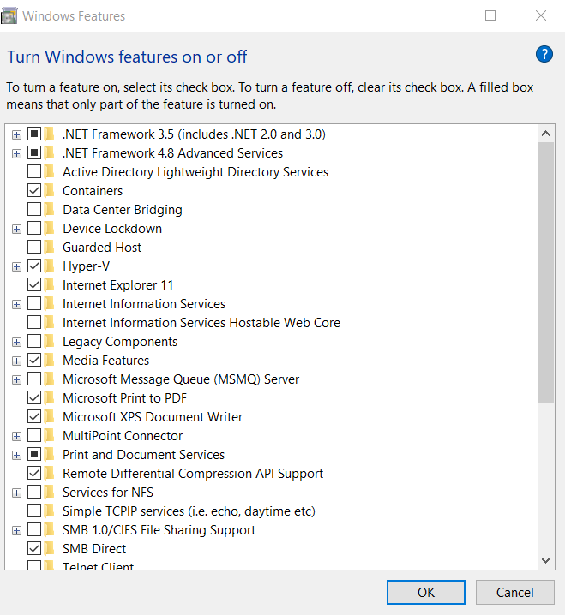
Setting Windows 10 Features
To avoid problems with the installation of VirtualBox on Windows, we must do the following:
Click on the Start Button and type: windows features
to run the program that turns Windows features on / off.
Make sure that the following features are disabled:
Hyper-V
Windows Sandbox
Make sure that the following features are enabled:
Virtual Machine Platform
Windows Hypervisor Platform
Open a CMD window as administrator and type
type the following command:
bcdedit /set hypervisorlaunchtype off

Slide 8
Installing the VirtualBox on Windows 10
VirtualBox is a general-purpose full virtualizer for x86 hardware, targeted at server, desktop and embedded use.
You can use VirtualBox to install different types of operating systems on your native operating system.
For example, if my computer is running the Windows 10 operating system, I can install and run the Ubuntu operating system on top of Windows 10 as a virtual machine.
Go to https://www.virtualbox.org/
Click on the download box to download the latest version (e.g. version 6.1.32)

Slide 9
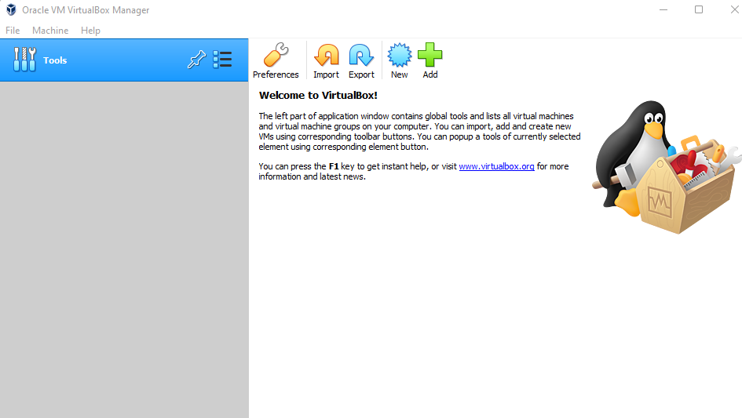

Slide 10
Installing Ubuntu on VirtualBox
Ubuntu is a complete Linux operating system, freely available with both community and professional support.
Go to https://ubuntu.com/download/desktop to download the ISO system image of Ubuntu, e.g. ubuntu-18.04.3-desktop-amd64.iso (approximately 2 GB)
Recommended system requirements:
2 GHz dual core processor or better
4 GB system memory
25 GB of free hard drive space

Slide 11
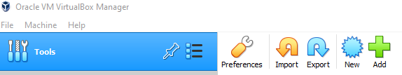
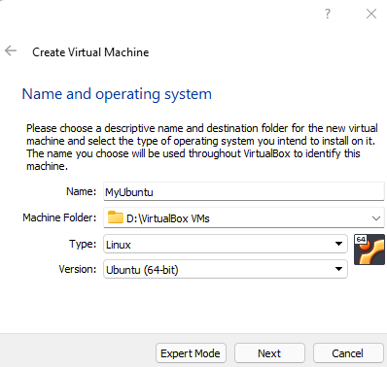
Creating a Virtual Machine
Click New in the VirtualBox Manager window (or Machine → New) from the menu bar. A wizard will guide you through setting up a new virtual machine (VM).
The Name of the VM will later be shown in the machine list of the VirtualBox Manager window.
The Machine Folder is the location where all VMs will be stored on your computer by default.
For Operating System Type and Version, enter the operating system that you want to install.
Click Next

Slide 12
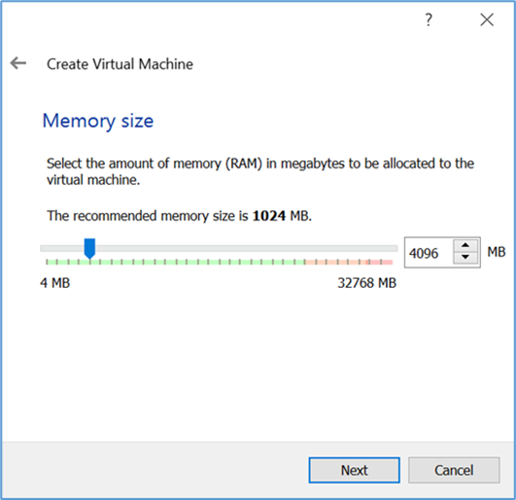
Memory Size
Select the Memory (RAM) that Oracle VM VirtualBox should allocate every time the virtual machine is started.
This allocated memory will be taken away from the overall memory of the host, while the VM is running.

Slide 13
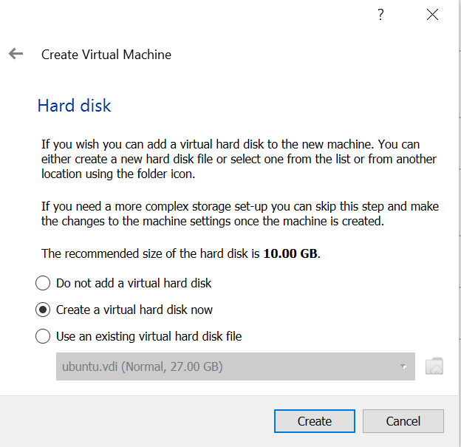
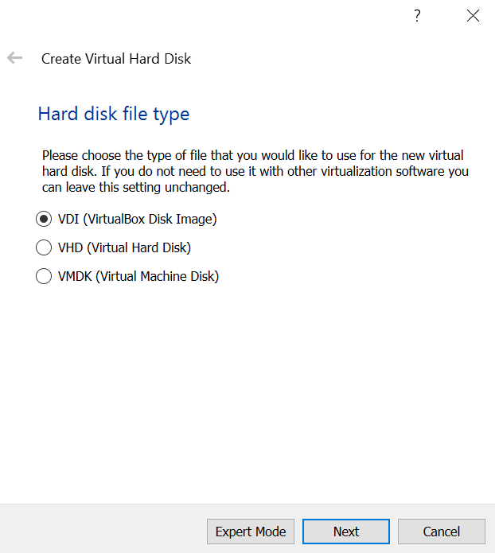
Hard Disk
To create a new, empty virtual hard disk, select 'Create a virtual hard disk now' and then click on the 'Create' button.
You can pick an existing disk image file.
The drop-down list will display all disk images which are currently remembered by Oracle VM VirtualBox. These disk images may currently or previously been attached to a virtual machine.
Hard Disk File Type
Choose 'VDI (Virtual Disk Image)'

Slide 14
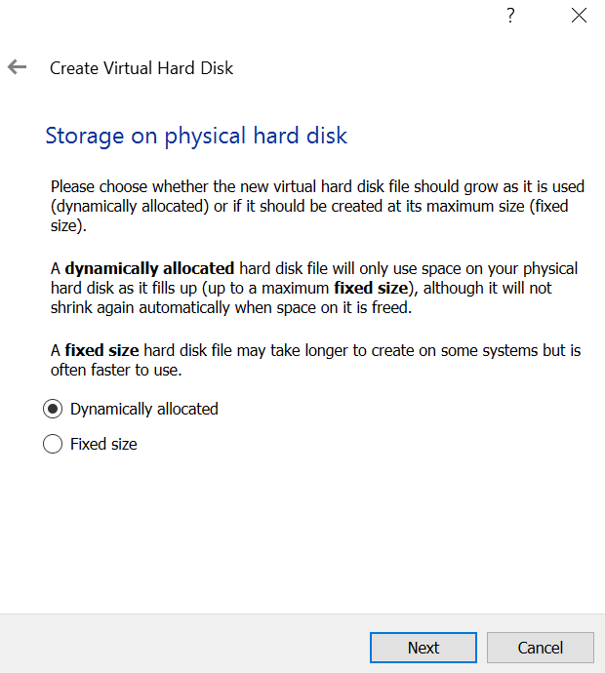
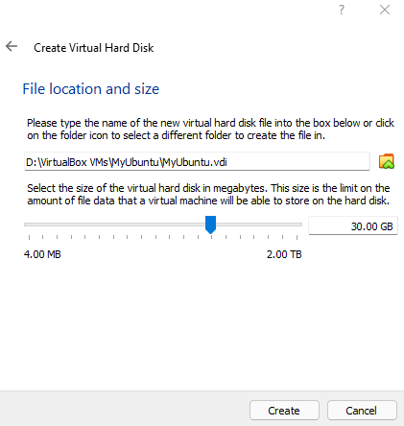
Storage on physical hard disk
Dynamic allocated: the disk space will grow as needed.
Fixed size: the entire disk space will be pre-allocated when the VM is created.
File allocation and size
You can decide on the size of the disk based on your needs for this VM. For the purpose of this course, a minimum of 25 GB is recommended.
Once you click on the Create button, the creation of the virtual machine will start.

Slide 15
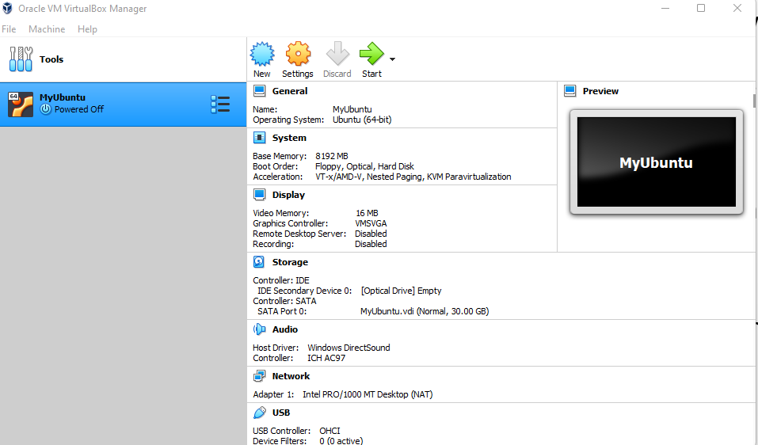
With the Ubuntu system selected in VirtualBox, click on the Settings icon.

Slide 16
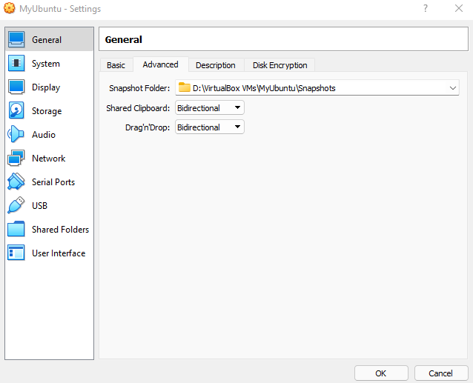
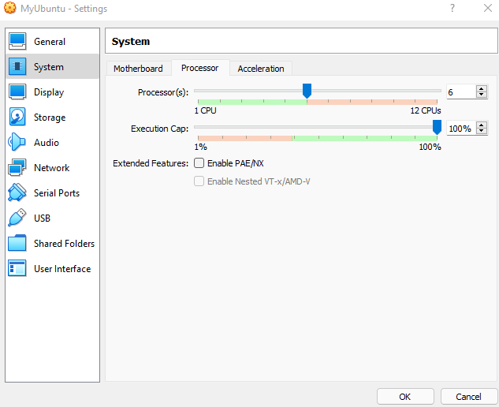
Click on the Advanced tab.
Change the values for Shared Clipboard and Drag'n'Drop to Bidirectional. This will allow you to copy and paste using the clipboard from your host machine to your virtual machine.
Click on System → Processor to choose the number of processors that the VM can use.

Slide 17
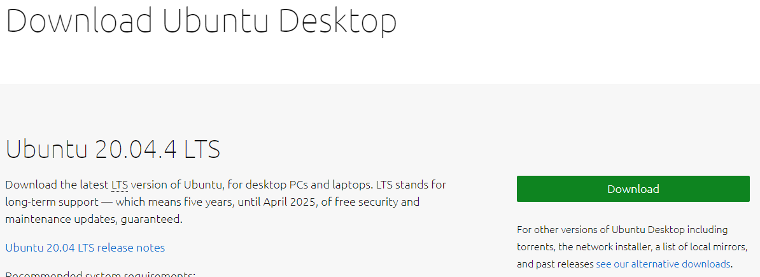
For the next step (on the following slide), you need to download an ISO image file of Ubuntu of the operating system to be installed on your virtual machine.
Go to https://ubuntu.com/download/desktop and click on the Download button to start the image download of Ubuntu 20.04.4 LTS, (filename: ubuntu-20.04.4-desktop-amd64.iso, size: 3.3 GB approximately)
This may take some time, depending on the speed of your network.

Slide 18
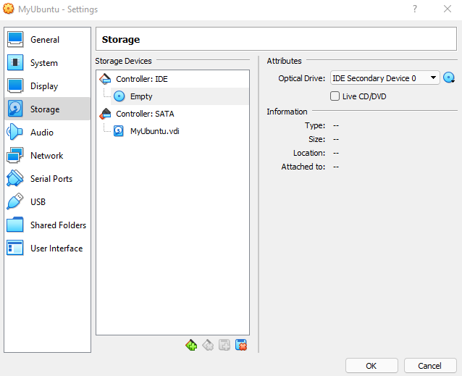
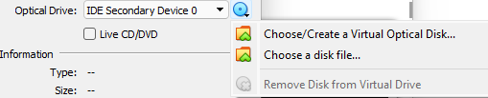
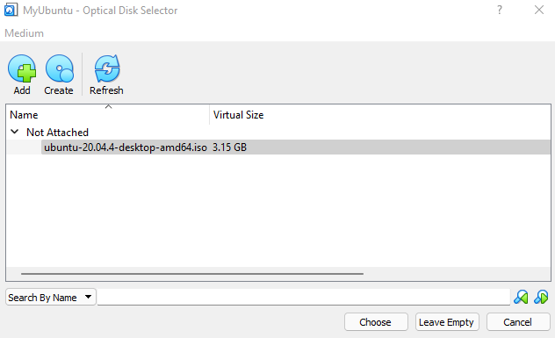
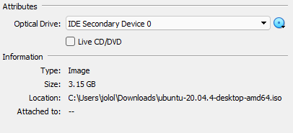
Click on Settings → Storage → Controller: IDE and select Empty
Click on the disk icon (on the right) and select choose Virtual Optical Disk File … from the menu.
Navigate and select the ISO image file of Ubuntu that you downloaded earlier.

Slide 19
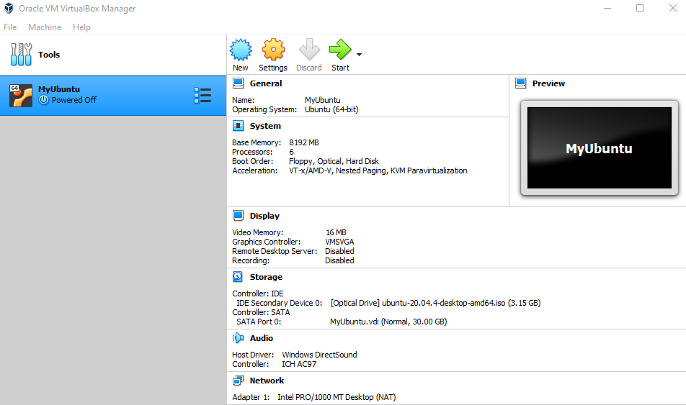
In the VirtualBox Window, with Ubuntu selected, click on the Start icon.
On the next window, click on Install Ubuntu.
Accept the default keyboard Layout (English US). Click Continue.
For the “Updates and other software” window, select the following options: “Normal Installation”, “Download updates while installing”, and “Install third-party software…”. Click Continue.
On the Installation Type window, accept the default option Erase disk and install Ubuntu. This will not erase you disk, but only the disk space allocated for the Ubuntu VM. Click Install Now.
Next, when it asks “Write the changes to disk?”, click Continue.
Next, it will ask for the time zone. Click Continue.

Slide 20
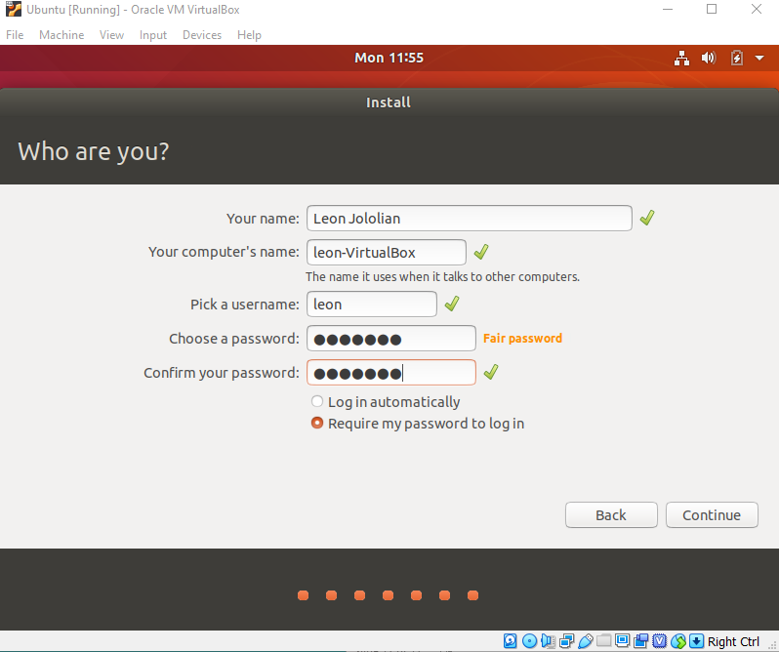
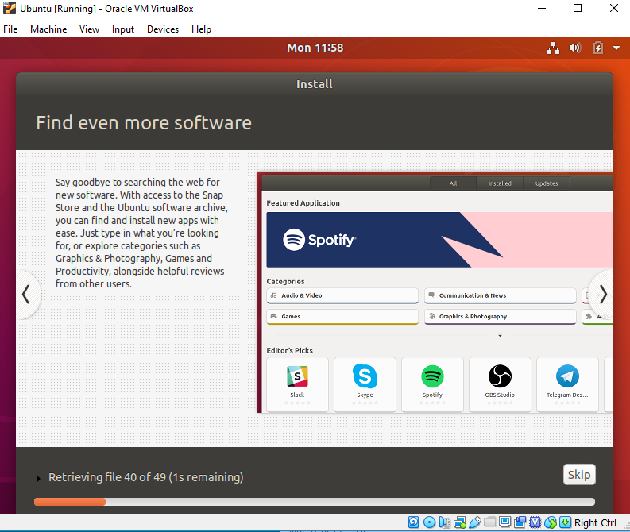
Next when it asks for user name and password, enter the corresponding values. Click Continue.
The installation of the VM with the Ubuntu OS will now start. It may take several minutes.

Slide 21
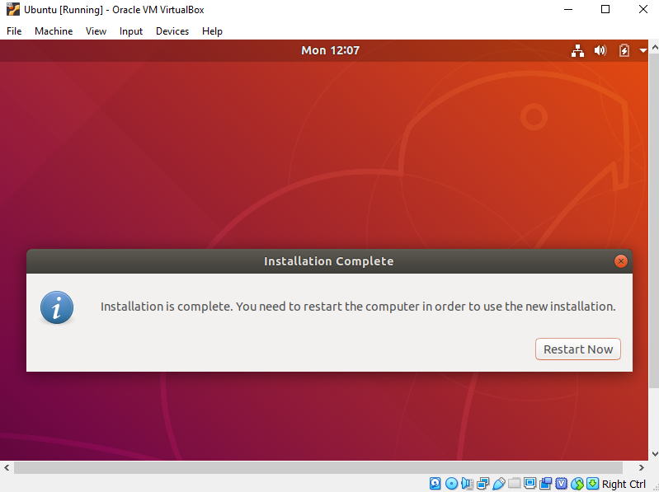
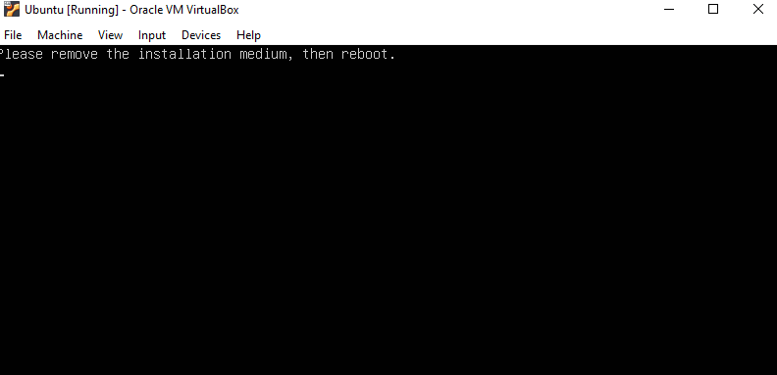
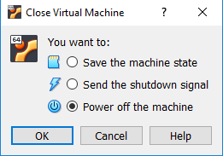
Once the installation is complete, a message box will appear. Click on the Restart Now button.
A window will appear with the message: Please remove the installation medium, then reboot. Close the window using the X icon.
A window appears with the title bar “Close Virtual Machine?”. Click on the option “Power off the machine”. Then, Click OK.

Slide 22
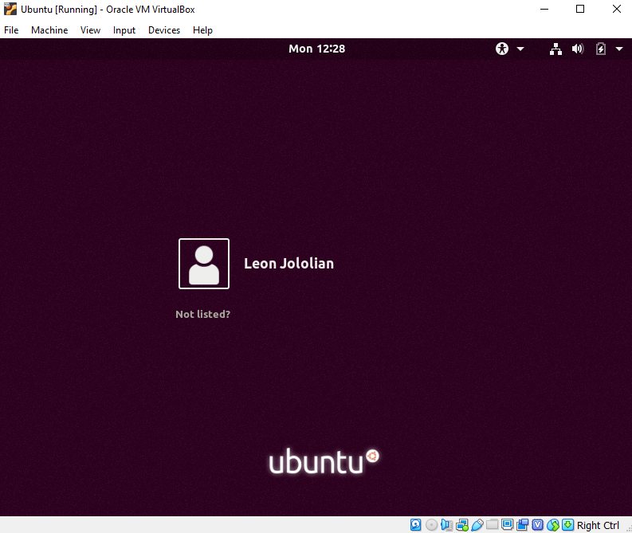
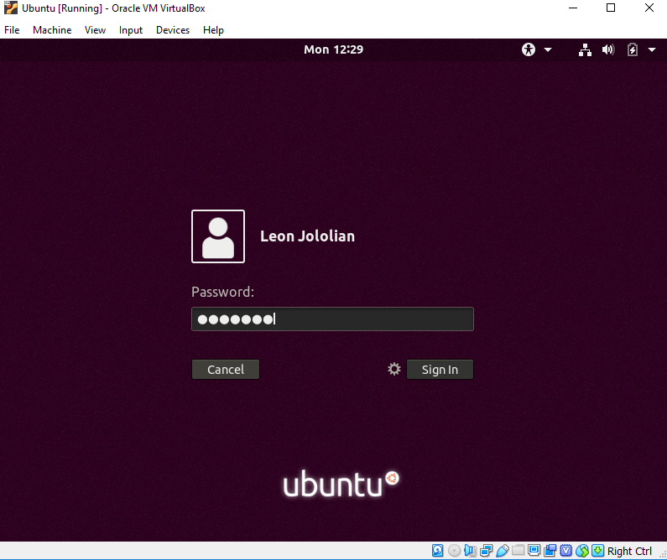
Now we are ready to boot the Ubuntu VM.
With Ubuntu selected, click on the Start icon in the VirtualBox window.
Click on the user name to get the login screen.

Slide 23
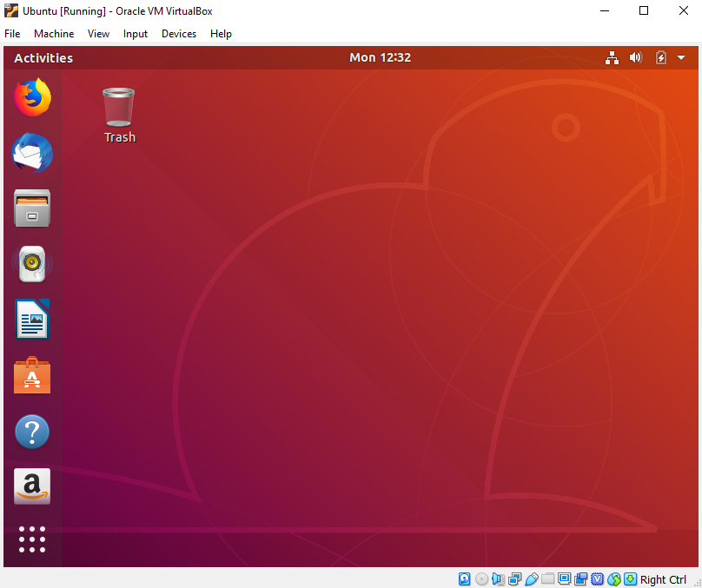

Slide 24
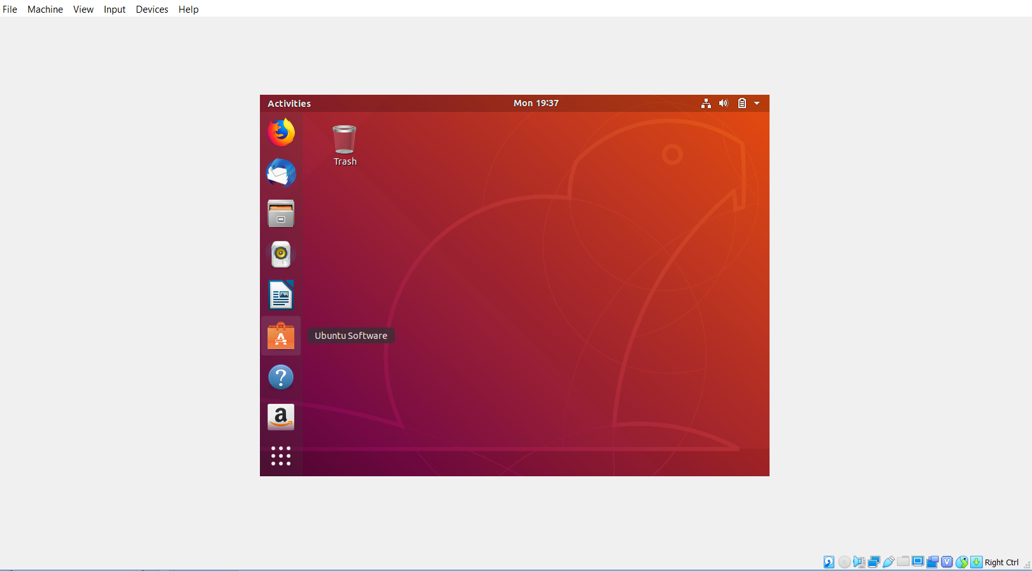
Problem: Window does not expand
After the install and entering the full screen mode the screen may look like this:

Slide 25
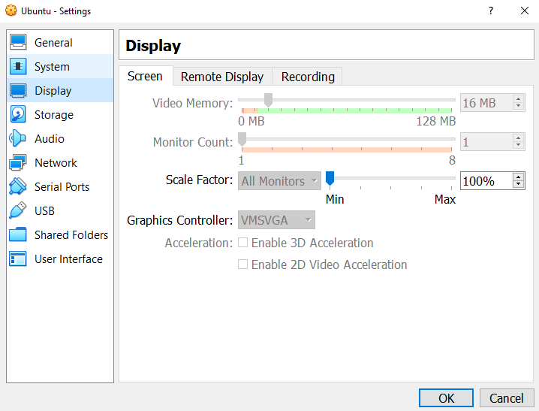
The Full-Screen Fix
In the VirtualBox window, select Ubuntu
Click on Settings → Display
For the Scale Factor, adjust the slider to the desired magnification, e.g. 200%

Slide 26
The Bash Shell
Dr. Leon Jololian

Slide 27
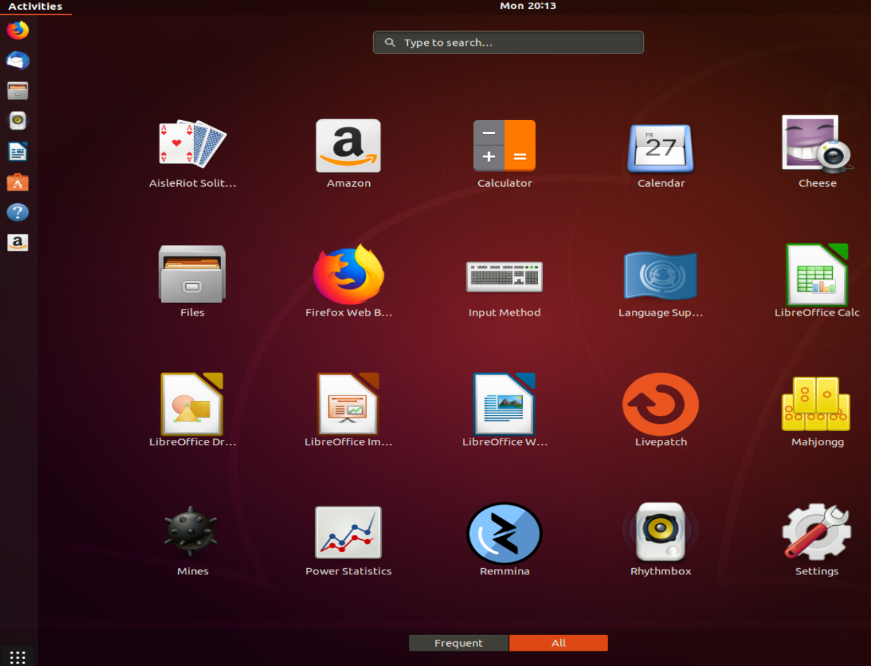
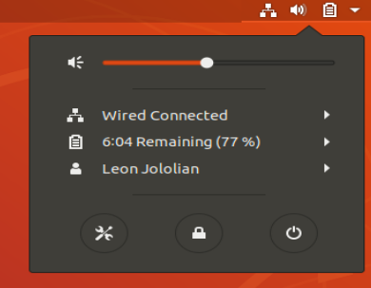

Accessing the Settings Window
1
2
2
1

Slide 28
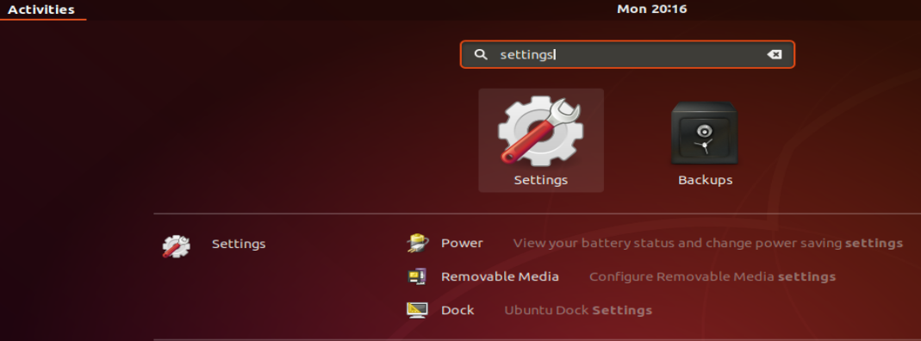
1
2

Slide 29
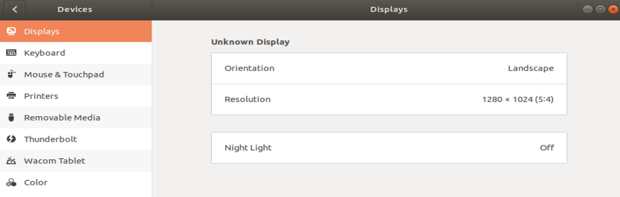
The Settings Window

Slide 30
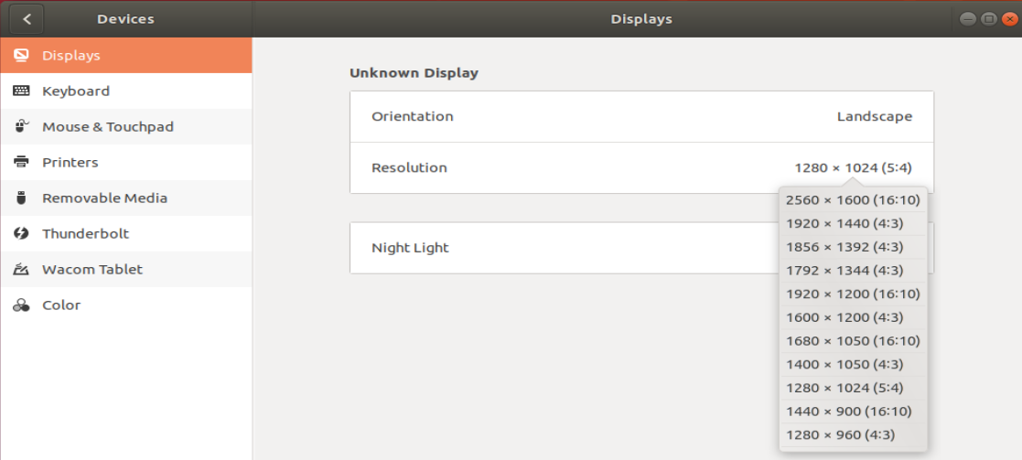
Changing the Screen Resolution
1
2
3

Slide 31
Update Windows 10 Version
To use the Copy/Paste functionality, you must have Windows 10 Insider build #17643 or later.
To install the update, select Start > Settings > Update & Security > Windows Update , and then select Check for updates. ...
If version 1903 isn't offered automatically through Check for updates, you can get it manually through the Update Assistant.
Click on “Update Now”
Run the exe file

Slide 32

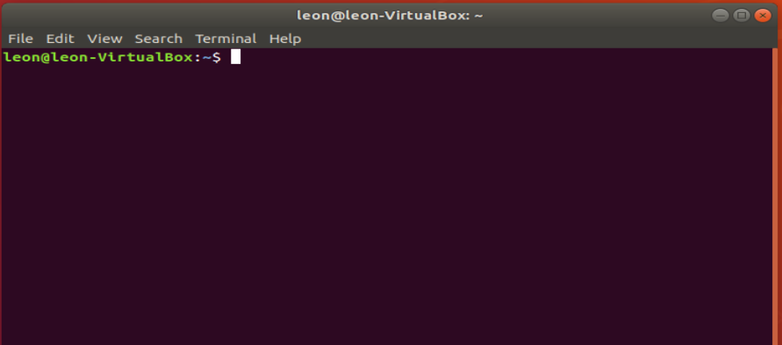
Opening a Terminal
Different ways of opening a terminal
Keyboard shortcut to start it: Ctrl-Alt-T
Click on the terminal icon
Click on “Activities”, then type at the top left of the screen the first few letters of "terminal", "command", "prompt" or "shell".
The Terminal window
will appear

Slide 33
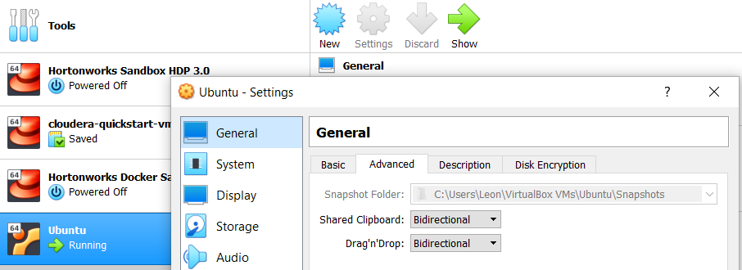
Enabling Copy/Paste between Windows and Ubuntu
In VirtualBox, click on Settings
Make sure that you have selected “Bidirectional” for both Shared Clipboard and Drag’n’Drop.
1
2
3

Slide 34
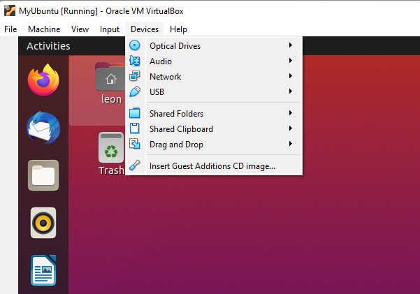
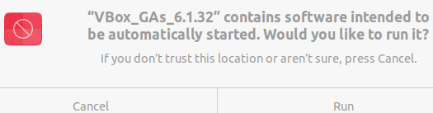

Enabling Copy/Paste and Resizing of the Ubuntu Desktop
In Ubuntu, open a Terminal and type the command:
sudo apt install linux-headers-$(uname -r) build-essential dkms
From the Ubuntu desktop, select devices → Insert Guest Additions CD Image …
In the popup window, click on Run :
Shutdown Ubuntu
Restart Ubuntu

Slide 35
Basic Shell Commands
command | description
clear | clear all previous commands' output text from the terminal
exit | quits the shell
alias, unalias | give a pseudonym to another command (you may need to enclose the command in quotes if it contains spaces or operators)
history | show a list of all past commands you have typed into this shell
Note: Use alias command (with no arguments) to display a list of all defined aliases.
Example: alias ll="ls -l"
Example: unalias ll

Slide 36
Directory Commands
ls | list files in a directory
pwd | displays the shell's current working directory
cd | changes the shell's working directory to the given directory; can be a relative or absolute path
mkdir | creates a new directory with the given name
rmdir | removes the directory with the given name (the directory must be empty)

Slide 37
ls – List storage
Lists directory contents
Options:
-a : list all files, including hidden ones.
-R : list subdirectories recursively.
-l : list one file per line; provides more information on files.
-t : (in combination with –l ) sort by modification time, newest first
-X : sort alphabetically by entry extension

Slide 38
pwd – Prints the name of the working directory
The pwd utility returns an absolute pathname of the current working directory, which does not contain the filenames dot or dot-dot.
cd — change the working directory
If no directory operand is given and the HOME environment variable is set to a non-empty value, the cd utility shall behave as if the directory named in the HOME environment variable was specified as the directory operand.
cd .. : changes to the parent of the current directory.
cd ~ : takes you to your home directory.
Relative and Absolute paths

Slide 39
Creating Folders and Files
# Use mkdir to create a new directory
mkdir dir
# The "-p" option means create the parent directories, too:
mkdir -p a/b
# Create a directory with a space in its name:
mkdir "folder 1"
mkdir "folder 4" "folder 5"
# To remove a directory:
rmdir abc
rmdir "folder 4" "folder 5"

Slide 40
File Operations
cp | copies a file or directory
mv | moves (or renames) a file or directory
rm | deletes a file
touch | update the last-modified time of a file (or create an empty file)
# create a file abc under the folder a/b
mkdir -p a/b
touch a/b/abc
# delete the folder a and all its contents recursively
rm -r a
Note: touch can also be used to update the last time the file was modified

Slide 41
Syntax of mv command: mv [filename] [new_filename]
# create the file “abc”, then rename it to “def”
touch abc
mv abc def
# Making a copy of a file in other directories
touch abc
mkdir -p a/b
mv abc a/b/def
# By using the -i option, it forces mv to prompt before moving the file:
rm -i abc

Slide 42
File Examination
cat | output the contents of a file
more (or less) | output the contents of a file, one page at a time
head, tail | output the beginning or ending of a file
wc | output a count of the number of lines, words, and characters in a file
du | report disk space used by a file/directory
diff | output differences between two files

Slide 43
# To display the entire contents of a file
cat file.txt
# to display the first 10 lines of a file:
head file.txt
# to display the first 5 lines of a file:
head -n 5 file.txt
# to display the first 5 lines of a file and the name of the file:
head -v -n 5 file.txt
# to display the last 10 lines of a file:
tail file.txt
# to display an arbitrary number of lines from the end of the file:
tail -n 5 file.txt

Slide 44
# To display a file that is too long to be displayed on the screen, we can use the more command:
more file.txt
# We can “pipe” the output of a command, with an expected large output, to “more”. This will allow us to view the file one page at a time
dmesg | more
Note: the dmesg command displays kernel related messages.
# To display the output using 10 lines at a time
more -10 file.txt
# Displays the number of disk blocks in the a directory along with its sub-directories:
du /etc

Slide 45
# show file contents or output of a command, one page at a time
less file.txt
dmesg | less
# To start at first occurrence of pattern “file” in the file:
dmesg | less -p "file“
# Show output along with line numbers:
dmesg | less -N
# Show the number lines, words, and characters in file
wc file.txt
# use the -m option to print the number of characters
wc -m file.txt
# use the -l option to print the number of newlines in the file
wc -l file.txt

Slide 46
File Permission
chmod | change the permissions on a file or group of files
chown | change the owner of a file
chgrp | change the group associated with a file
umask | change the default permissions given to newly created files
ls -l
-rw-r--r-- 1 leon leon 209 Aug 27 20:10 abc
Regarding the file abc, the above tells us that:
the user has read and write access
The group (to which the file belongs) has read acces
Everyone else (others) has read access.

Slide 47
There are three types of permissions that can be associated with a file:
Read permissions denoted by r → 4
Write permission denoted by w → 2
Execute permissions denoted by x → 1
To change the file permissions we can use a command chmod. The following command gives the user r/w access, the group r/x access, and others r access:
chmod 654 chmod.txt
The following command gives the user r/w access on the file abc:
chmod u+rw abc
To give a write permission to everyone on the file abc:
chmod a+w abc
To remove the write permission for others:
chmod o-w abc

Slide 48
Searching and Sorting
grep | search a file for a given string or expression
sort | convert an input into a sorted output
uniq | strip duplicate lines
find | search for files by name within a given directory
xargs | launch a command over each of a set of lines of input (often used with find)
locate | search for files by name on the entire system
which | shows the complete path of a command or file

Slide 49
Compression
zip, unzip | create a .zip archive or extract its contents
tar | Unix archiving/de-archiving program
gzip, gunzip | GNU compression/decompression programs
bzip2, bunzip2 | improved compression/decompression programs

Slide 50
System Information
date | outputs the current date/time
cal | outputs an ASCII calendar
uname | print information about the system
time | measure how long a program takes to run

Slide 51
Process Management
ps | list the processes you are running; every process has a unique integer id number (PID)
top | see what processes are using the most CPU/memory, and show system memory/CPU stats
kill | terminate a process
killall | terminate a group of processes by name
^C or ^\ | (hotkey) terminates (kills) the currently running process
^Z | (hotkey) suspends the currently running process
& | (special character) when & is placed at the end of a command, that command is run in the background (shell does not wait for the command to finish before returning to the input prompt)
bg, fg | starts a suspended process running in the background or foreground

Slide 52
ps lists running processes.
to list all processes running on system: ps –A
to search for the Firefox process: ps -A | grep firefox
top displays a list of processes, with the ones using the most CPU at the top.
kill is used to kill a process
Killall firefox : kills the process associated with the firefox program

Slide 53
Users and Groups
whoami | outputs your user name
passwd | changes your password
groups | list the groups to which a user belongs
sudo | execute a single command as the super-user
su | log in to a shell as the super-user

Slide 54
Multi-User Environment
hostname | outputs the name of the current computer/server
w, finger | see who is logged in to this computer
write | sends a message to another user logged in to this computer
wall | broadcasts a message to all other users logged in to this computer
.plan | (filename) a special hidden file you can create in your home directory, whose contents will be displayed when other users run finger on you. Was originally intended to be used to tell others what you are up to right now. (the Twitter of the 1970s!)

Slide 55
Network
links, lynx | text-only web browsers (yes, really)
ssh, sftp, scp | connect to a remote Unix server; open a shell on it or send/receive files from it
wget | download from a URL and save it to a file on the local hard drive
curl | download from a URL and output its contents to the console
pine, mail | text-only email programs

Slide 56
Text Editors
pico, nano | crappy but simple text editors (recommended)
emacs | a complicated text editor (not recommended)
vi, vim | another complicated text editor (not recommended)

Slide 57
whoami – returns the user name
# The variable HOME is assigned the path to the user’s home directory:
echo $HOME
# find out the id of current user
whoami
#create a file called abc on the desktop
cd Desktop
touch abc
# To find which shell you are using
echo $0

Slide 58
Installing PuTTY on Windows
PuTTY is a SSH and telnet client, developed originally for the Windows platform.
PuTTY is open source software that is available with source code and is developed and supported by a group of volunteers
You can download PuTTY from: https://www.putty.org/
The downloaded file is:
putty-64bit-0.75-installer.msi

Slide 59
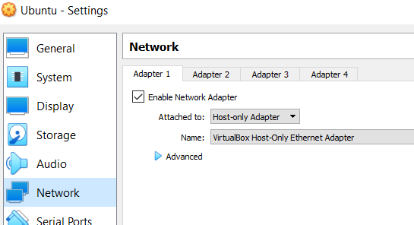

Installing SSH on Ubuntu
Installing the SSH software on Ubuntu
sudo apt-get install ssh
Enable the SSH server service
sudo service ssh start
Check the SSH status
sudo service ssh status
In the VirtualBox Window Right-click the Ubuntu virtual machine, select "Settings" → "Network".
Next to "Attached to", select "Host-only Adapter".

Slide 60
In Ubuntu, open a terminal and type the following command in order to find the IP assigned to the virtual machine:
ip addr show
1: lo: <LOOPBACK,UP,LOWER_UP> mtu 65536 qdisc noqueue state UNKNOWN group default qlen 1000
link/loopback 00:00:00:00:00:00 brd 00:00:00:00:00:00
inet 127.0.0.1/8 scope host lo
valid_lft forever preferred_lft forever
inet6 ::1/128 scope host
valid_lft forever preferred_lft forever
2: enp0s3: <BROADCAST,MULTICAST,UP,LOWER_UP> mtu 1500 qdisc fq_codel state UP group default qlen 1000
link/ether 08:00:27:06:cc:d4 brd ff:ff:ff:ff:ff:ff
inet 192.168.56.101/24 brd 192.168.56.255 scope global dynamic noprefixroute enp0s3
valid_lft 1151sec preferred_lft 1151sec
inet6 fe80::e2f4:31dc:27af:95c7/64 scope link noprefixroute
valid_lft forever preferred_lft forever

Slide 61
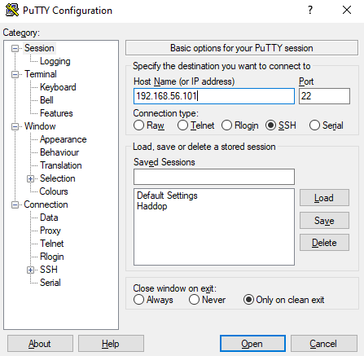
Connecting from Windows to Ubuntu using PuTTY
Run PuTTY on Windows
Enter the IP of the Ubuntu VM
Click on the Open button
A terminal window will open on Windows
Login to your VM

Slide 62
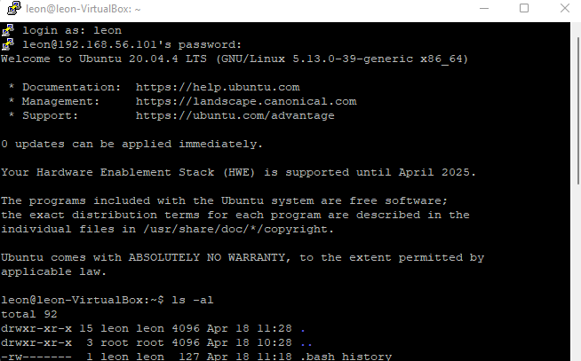
Using Username and Password to Login to VM

Slide 63
Creating New Private and Public Keys
Launch PuTTYgen on Windows
Under Parameters, select RSA and make sure that the Number of bits in a generated key is set to 2048.
Under Actions → Generate a public/private key pair, click Generate.
You will be instructed to move the mouse cursor around within the PuTTY Key Generator window as a randomizer to generate the private key.
Optional: You can also provide a Passphrase for extra protection. The purpose of the passphrase is to encrypt the private key. This makes the key file by itself useless to an attacker.

Slide 64
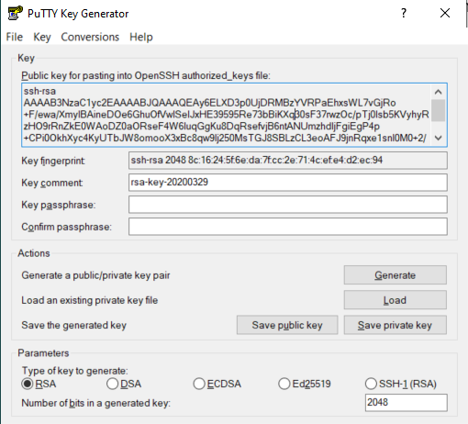
Once the key information appears, click on Save private key under Actions / Save the generated key.
Save the private key to the desktop as id_rsa.ppk.
Click on Save public key to save to a file (e.g., id_rsa.pub) the public key displayed in the box under Key / Public key for pasting into OpenSSH authorized_keys file.

Slide 65
Copy the Public Key to the Server
Launch PuTTY and log into the VM with your existing user credentials.
Use your preferred text editor to create and/or open the authorized_keys file: $ vi ~/.ssh/authorized_keys
Copy and paste the public key into the authorized_keys file.
Save the file and close the text editor. You can verify that the public key has been saved to the file using: $ cat authorized_keys
Set the permissions of the authorized_keys read/write by owner only: $ chmod 600 ~/.ssh/authorized_keys

Slide 66
Set the permissions on the .ssh folder to read/write/execute by owner only: $ chmod 700 ~/.ssh 700 .ssh
To turn-off password authentication on VM, start by making a copy of the configuration file:
$ sudo cp /etc/ssh/sshd_config /etc/ssh/sshd_config.bak
In the file sshd_config, change the line:
PasswordAuthentication yes to PasswordAuthentication no
Restart the SSH server:
$ sudo service ssh restart
Logout from the VM.

Slide 67
Connecting to VM with Private Key
Now it is time to test SSH key authentication. The PuTTYgen tool can be closed and PuTTY launched again:
Launch PuTTY again
Enter the remote server Host Name or IP address
Under Category, navigate to Connection → SSH → Auth
Click Browse... under Authentication parameters / Private key file for authentication
Locate the file id_rsa.ppk where the private key is saved, and click on Session (under Category)
Enter the IP of the VM. Finally, click Open again to log into the VM without having to enter a password.

Slide 68
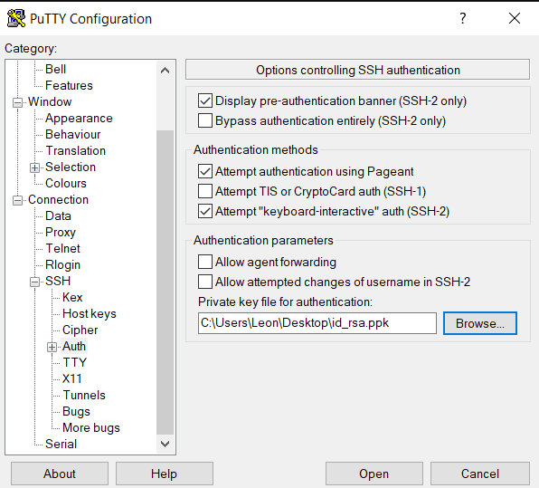

Slide 69
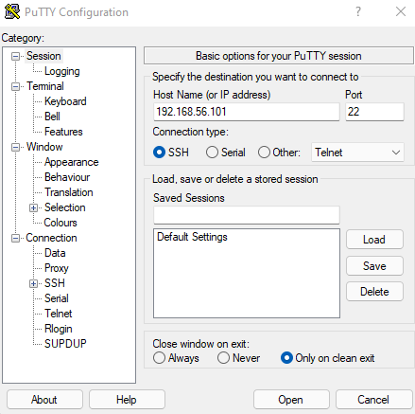

Slide 70
User Management
Password file entry (/etc/passwd):
leon:x:1000:1000:Leon Jololian,,,:/home/leon:/bin/bash
· login name
· optional encrypted password
· numerical user ID
· numerical group ID
· user name or comment field
· user home directory
· optional user command interpreter
To change password, use the command: passwd

Slide 71
Creating/Deleting a User Account
Creating a user account:
Open a terminal
Run the command: sudo adduser <user login name>
Enter password and other needed info to create a user
New username would be added to /etc/passwd file, and encrypted password stored in the /etc/shadow file
To delete user account:
userdel -r <user login name>
sudo cat /etc/passwd | grep john
john:x:1001:1001:John Doe,122,234-567-8990,111-222-3333:/home/john:/bin/bash
sudo cat /etc/shadow | grep john
john:$6$gO67v0rv$u3T2IfrLyMCIVgnAITq5cqCXyf16m6zqHM35oKr9A2g6wrebPgvUtLWMMZHH6z2c/Jqv.fq.YODJHiY8vxxmZ.:18137:0:99999:7:::

Slide 72
The Fields in the /etc/shadow File:
Username : login name.
Password : encrypted password. The password should be minimum 8-12 characters long including special characters, digits, lower case alphabetic and more. Usually password format is set to $id$salt$hashed, The $id is the algorithm used On GNU/Linux as follows:
$1$ is MD5
$2a$ is Blowfish
$2y$ is Blowfish
$5$ is SHA-256
$6$ is SHA-512
Last password change : Days since Jan 1, 1970 that password was last changed
Minimum : The minimum number of days required between password changes
Maximum : The maximum number of days the password is valid Warn : The number of days before password is to expire that user is warned that his/her password must be changed
Inactive : The number of days after password expires that account is disabled
Expire : days since Jan 1, 1970 that account is disabled.

Slide 73
Transferring Files between Windows and Ubuntu
WinSCP is an SFTP client and FTP client for Microsoft Windows.
You can use it to copy files between a local computer and remote servers using FTP, FTPS, SCP, SFTP, WebDAV or S3 file transfer protocols.
It also works in transferring files between Windows and Ubuntu.
To install:
Go to https://winscp.net and click on Download.
The installation is straight forward.

